Slide 1
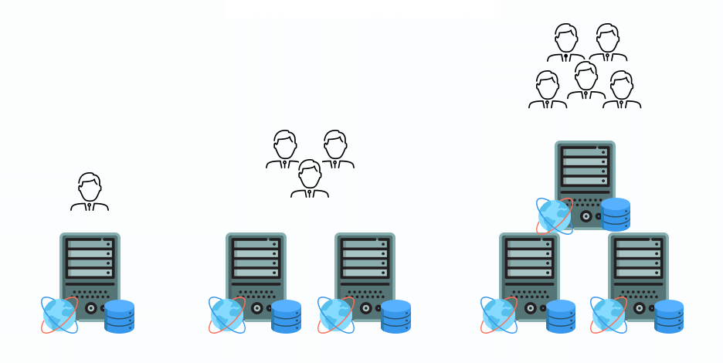
Scalability Quiz
https://bit.ly/3M98H7m

